Slide 1





DON BOSCO INSTITUTE OF TECHNOLOGY
Department of Information Science and Engineering
INTERNSHIP PROJECT ON EMAIL SPAM BASED DETECTION USING DATA SCIENCE
Internship in Vtricks Technologies
Submitted by:- Under the Guidance of:- Umme Athiya Asst Prof Chaithra A S USN: 1DB16IS051 Dept. ISE , DBIT

Slide 2

Contents
Introduction.
Problem Definition.
Objectives.
Existing & Proposed System.
Methodology.
Outcomes.
Conclusion.
References.

Slide 3
Introduction
Data science is an inter-disciplinary field.
It uses scientific methods, processes, algorithms and system.
Machine Learning is the scientific study of Statistical Models & Algorithms.

Slide 4



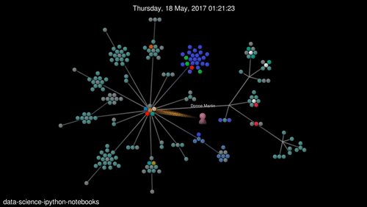


Slide 5
Problem Definition
Spams can crash mail servers & fill up hard drives.
Identity Theft.
Critical e-mail message are missed and delayed.
Unwanted e-mails irritating internet connection.
Billions of dollars lost worldwide.

Slide 6
Objectives
To give knowledge to the user about the fake e-mails & relevant e-mails.
To classify that mail spam or not.
Fig 1:-Email Spam Detection
Spam
Spam Classifier System
New Email
Non Spam

Slide 7
Existing & Proposed System
Existing System:-
Email has become one of the most important forms of communication.
Links in spam emails lead websites with malware or phishing schemes.
Proposed System:-
The approach to determine the existence of common keywords in spam.
Email Filtering.
c) Advantages:-
Blocking Spam
Quarantining Spam
Reporting Spam

Slide 8
Methodology
Fig 2:- Building Model
Prediction
Data Visualization
Giving insights from model results
Model Building
Gathering Data
Cleaning Data

Slide 9
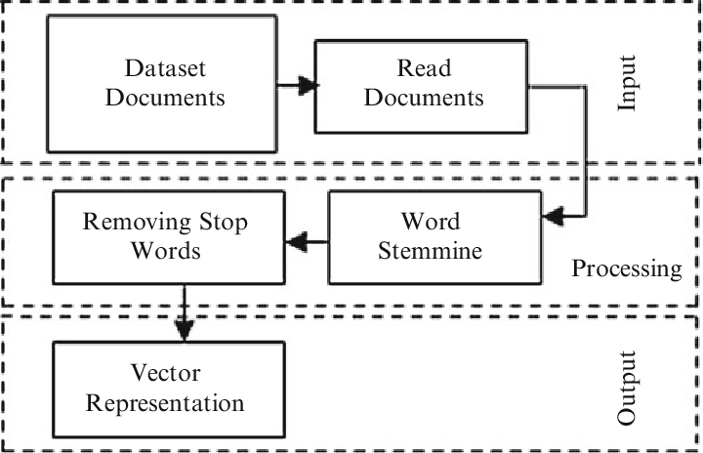
Methodology
Document Preprocessing:-
Tokenization
Lemmatization
Removal of Stop Word
Fig 3:- Document Preprocessing

Slide 10
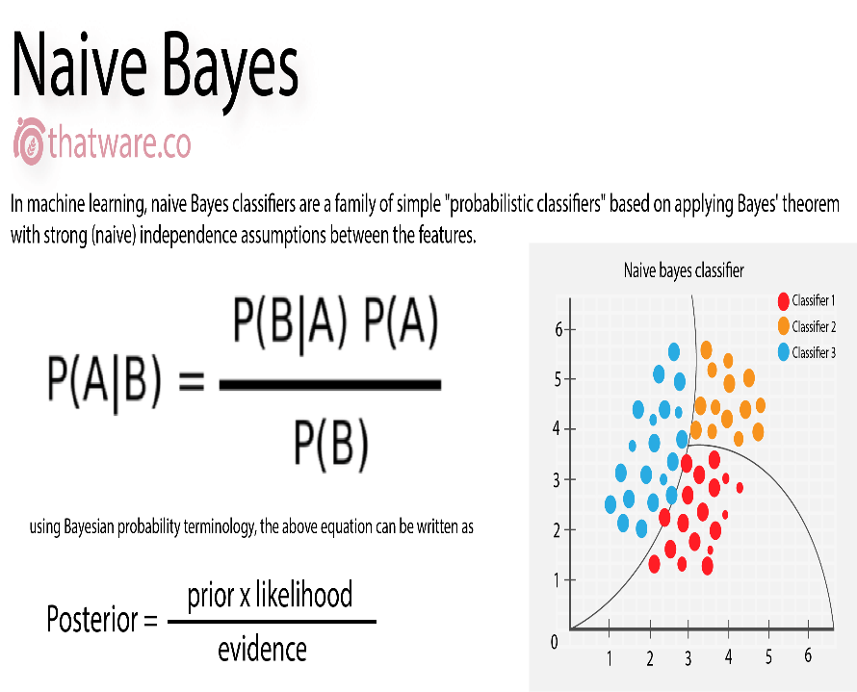

Methodology
a) Multinomial NB:-
Simple Probabilistic classifier that calculates a set of probabilities.
By counting the frequency & combination of values in given dataset.
Represented as a vector of feature values.
Fig 4:- Multinomial NB Fig 5: Application of Multinomial NB

Slide 11
Outcomes
Dataset Description:-
The default of credit card clients data set are used which are available from the machine learning repository.
Fig 6:- Dataset Summary
Attributes | Values
a] Dataset | Rows – 5572 & columns – 2.
b] Target | Ham(1)- 4825, Spam(0)-747.
c] Top 10 Spam words | call, free, txt, ur, u, mobile, text, stop, claim, reply.
d] Top 10 Ham words | It, get, ok, go, got, know, like.

Slide 12
Outcomes
Evaluation of Results:-
Fig 7:- Various Algorithm Result Table
SL NO | Classification Algorithms | Accuracy | Confusion Matrix | Precision | f1- score | Recall
1. | Decision Tree | 96.3212% | [ 1915 47] [ 35 232] | 0.98 | 0.85 | 0.87
2. | Multinomial NB | 93.591% | [ 889 64] [ 155 7] | 0.54085 | 0.66348 | 0.8580
3. | Random Forest | 97.219% | [ 953 0] [ 88 74] | 1.00 | 0.63 | 0.46

Slide 13
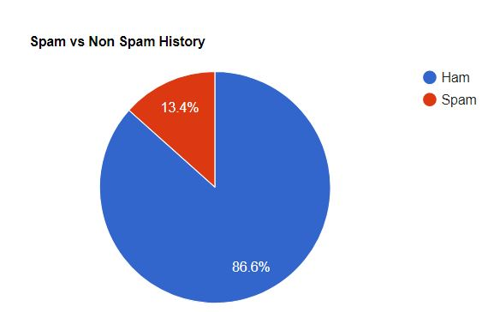
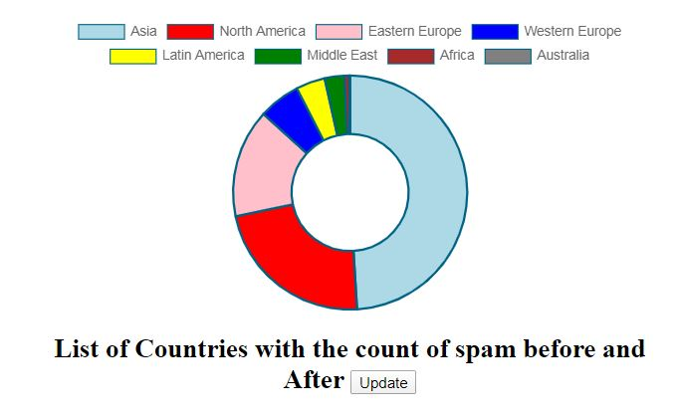
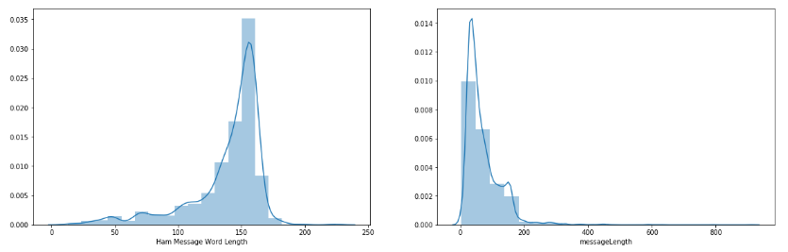
Outcomes
Fig 8: Spam vs Non Spam Fig 9:- Doughnut Chart
Fig 10:- Ham & Spam Message Length

Slide 14
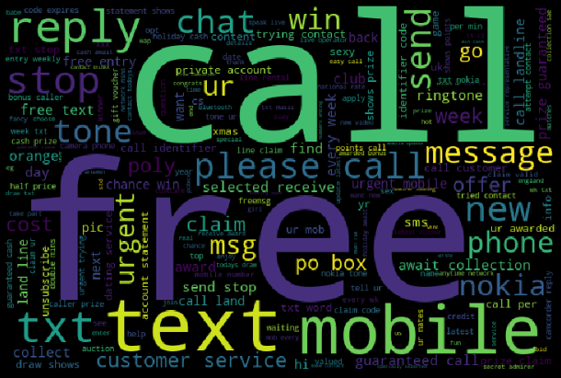
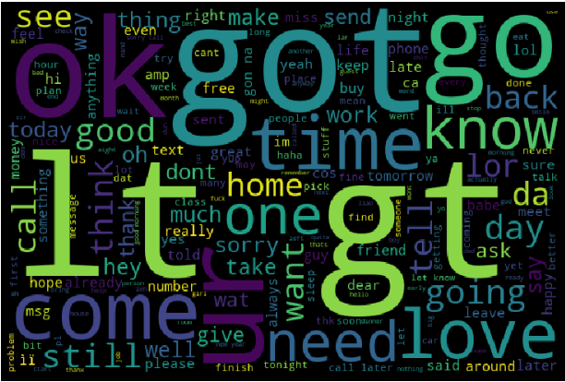
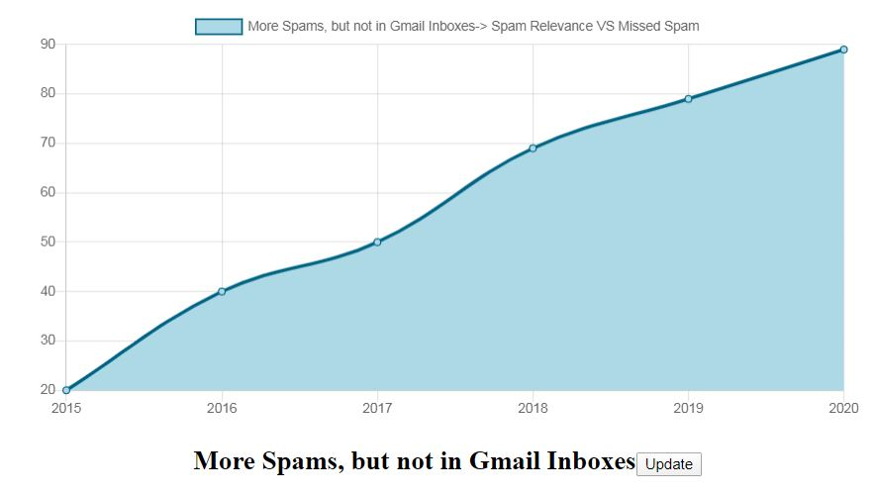
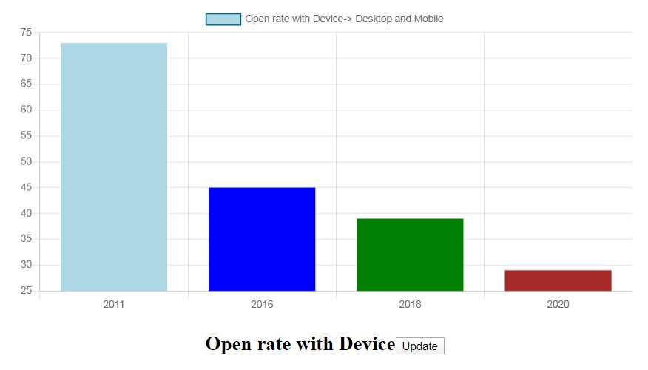
Outcomes
Fig 11: Spam Word Cloud Fig 12: Ham Word Cloud
Fig 13: Line Graph Fig 14: Bar Graph(Desktop Vs Mobile)

Slide 15
Conclusion
The use of machine learning techniques for email spam detection are:-
a) We are able to classify the emails as spam or non spam.
The proposed system uses Decision Tree, K Neighbor Classifier and Random Forest and Multinomial Naïve Bayes.
The classifier employed here is Multinomial Naïve Bayes.

Slide 16
References
Machine Learning Methods for Spam Email Classification by W. A Awad & S. M Elseuofi in 2017, IEEE
An Expert Spam Detection on Extreme Learning Machine by Yilmaz kaya
& Omer Faruk 2013, IEEE.

Slide 17

THANK YOU
Special Thanks to Vtricks Technologies

